Slide 1
Collection
Parinya Sanguansat

Slide 2
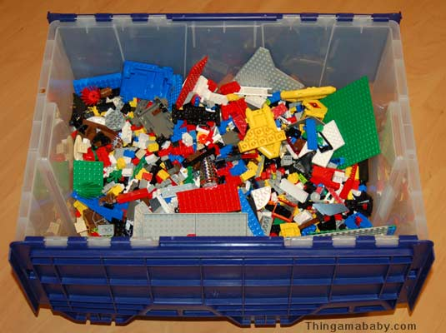
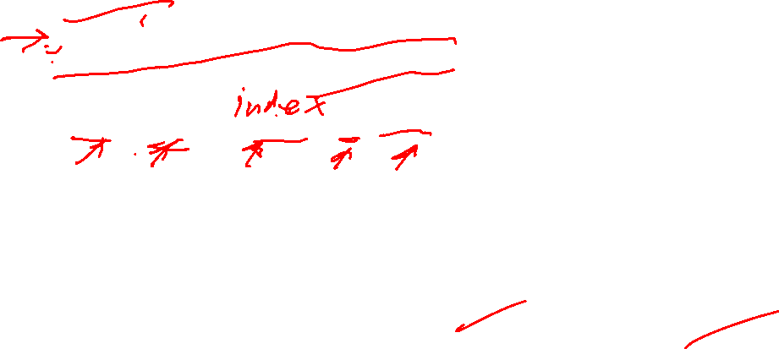
Collection
No order
Duplicate data items are permitted
Service
add, remove, contains, size, isEmpty
C
B
C
D
A

Slide 3

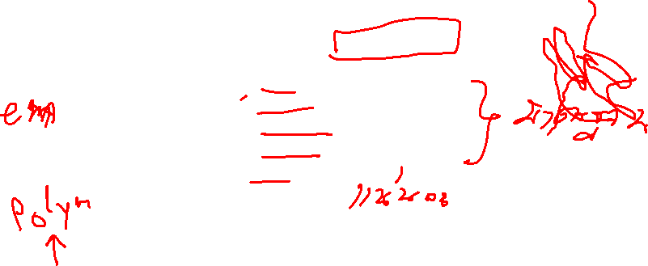
Collection Interface
C#, No modifier in interface
public interface Collection
{
void add(object e);
void remove(object e);
bool isEmpty();
bool contains(object e);
int size();
}
object = System.Object

Slide 4
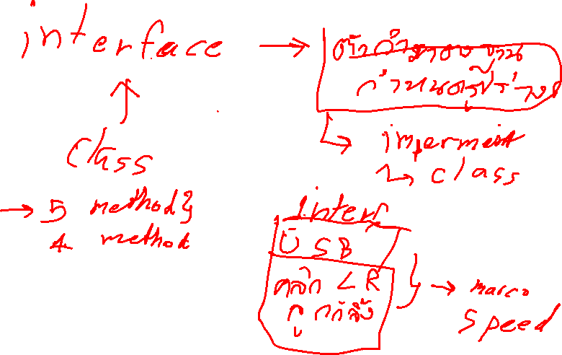

Slide 5
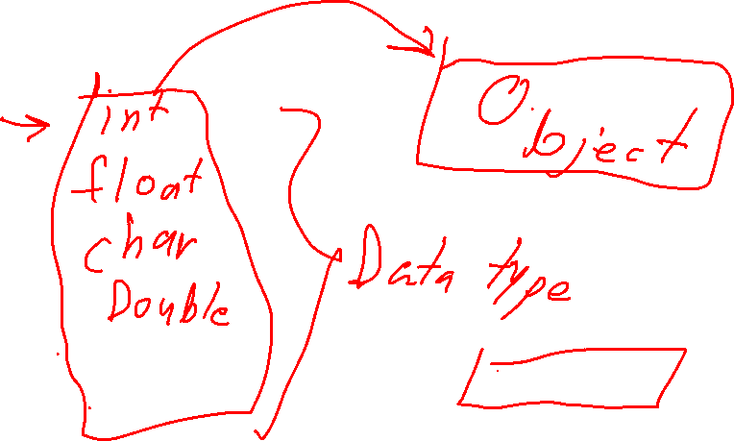

Slide 6
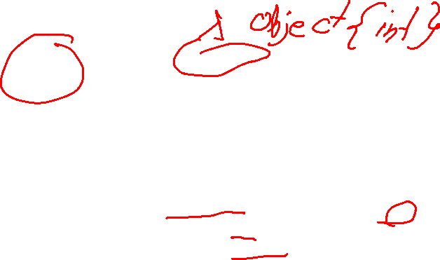
System.Object
System.Object is the ultimate base class of all classes
Alias: object
Autoboxing
Array of object: can contain multiple classes
int x = 1;
object x = 1;
x is int
x is object{int}
object[] x = new object[2];
x[0] = 1;
x[1] = "abc";
x[0] is object{int}
x[1] is object{string}

Slide 7
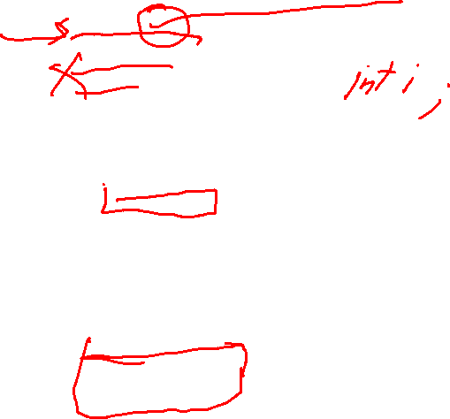
var vs object vs dynamic
var is the declared keyword of variable type
object is the root class
dynamic is the declared keyword of variable type that bypass compile-time type checking but resolve it at run time (no code intelligence)
var i = 10; // implicitly typed
int i = 10; // explicitly typed
var i; // error
object x = 1; // object{int}
object x; // object
dynamic x = 1; // dynamic{int}
dynamic x; // dynamic

Slide 8
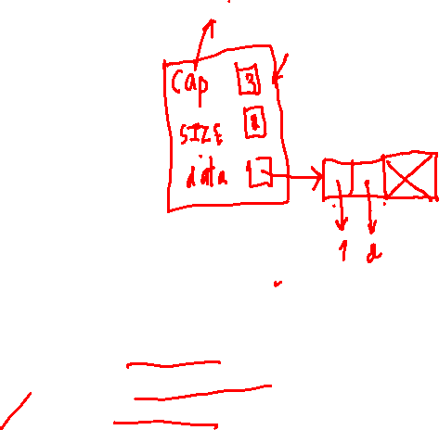
Implement with Array
ArrayCollection
5
cap
SIZE
data
3
5
3
0 | 1 | 2 | 3 | 4
Instance
Ant | Bat | Cat
null
public class ArrayCollection : Collection
{
private int SIZE;
private object[] data;
private int cap;
}

Slide 9
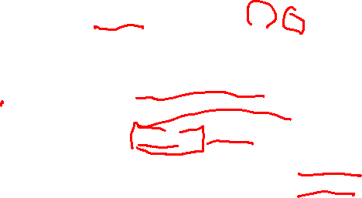
Array is reference type !!
Primitive data type (int, float, double, …) is value type
Each element in array only points to data but does not store data value
class test { public int data = 2;}
class Program
{
static void Main(string[] args)
{
test t = new test();
object[] a = new object[2];
a[0] = t; a[1] = t;
Console.WriteLine(((test)a[0]).data);
Console.WriteLine(((test)a[1]).data);
Console.ReadLine();
}
}
class Program
{
static void Main(string[] args)
{
int x = 2;
object[] a = new object[2];
a[0] = x; a[1] = x;
Console.WriteLine(a[0]);
Console.WriteLine(a[1]);
Console.ReadLine();
}
}
x = 3; a[0] = x; a[1] = x;
a[0] = x; x = 3; a[1] = x;
a[0] = x; a[1] = x; x = 3;
t.data = 3; a[0] = t; a[1] = t;
a[0] = t; t.data = 3; a[1] = t;
a[0] = t; a[1] = t; t.data = 3;

Slide 10
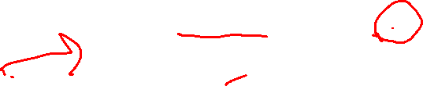
ArrayCollection: constructor
Create array
need to know capacity
user input
by constructor
public ArrayCollection(int cap)
{
data = new object[cap];
this.cap = cap;
}

Slide 11
ArrayCollection: size and isEmpty
int size()
bool isEmpty()
public int size()
{
return SIZE;
}
public bool isEmpty()
{
return SIZE == 0;
}

Slide 12
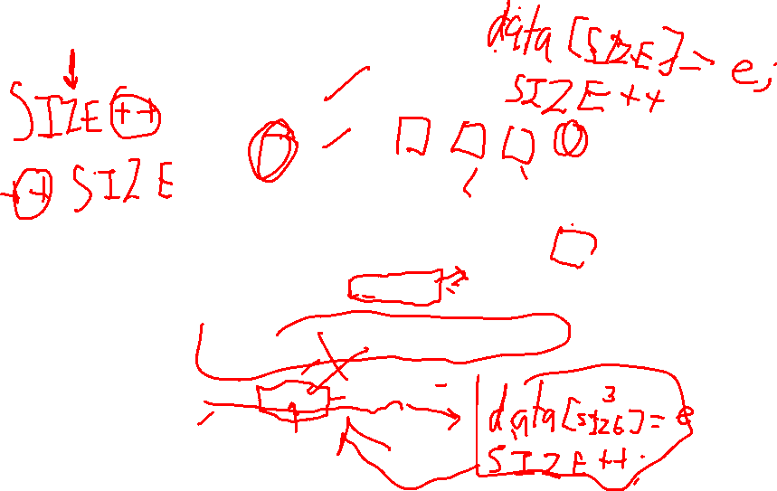
ArrayCollection: add
void add(object e)
cap
SIZE
data
5
0 | 1 | 2 | 3 | 4
3
0 | 1 | 2 | 3 | 4
4
Instance
Ant | Bat | Cat
Dog
public void add(object e)
{
if (e == null)
throw new ArgumentNullException();
data[SIZE++] = e;
}

Slide 13



ArrayCollection: add
void add(object e)
cap
SIZE
data
5
0 | 1 | 2 | 3 | 4
3
0 | 1 | 2 | 3 | 4
4
Instance
Ant | Bat | Cat
Dog
public void add(object e)
{
if (e == null)
throw new ArgumentNullException();
data[SIZE++] = e;
}

Slide 14











Ensure Capacity
private void ensureCapacity()
{
if (SIZE + 1 > data.Length)
{ //Increase Capacity
object[] tempdata = new object[2 * SIZE];
for (int i = 0; i < SIZE; i++)
tempdata[i] = data[i];
data = tempdata;
}
}
public void add(object e)
{
if (e == null)
throw new ArgumentNullException();
ensureCapacity();
data[SIZE++] = e;
}

Slide 15
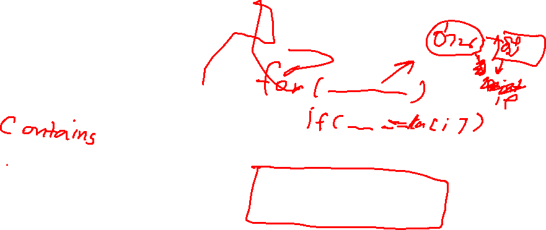
ArrayCollection: contains
bool contains(object e)
Instance.contains("Dog") // true
Instance.contains("Fox") // false
cap
SIZE
data
5
3
0 | 1 | 2 | 3 | 4
Instance
Ant | Bat | Cat
Dog
public bool contains(object e)
{
return indexOf(e) != -1;
}
private int indexOf(object e)
{
for (int i = 0; i < SIZE; i++)
if (e.Equals(data[i]))
return i;
return -1;
}

Slide 16
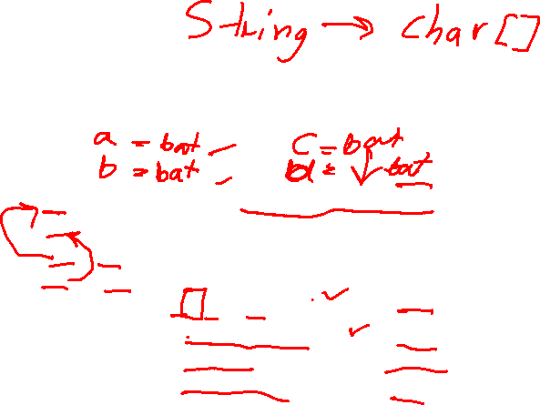
Equals vs ==
object.Equals compares object’s content
The == operator compares object reference
string a = new string(new char[] { 'b', 'a', 't' });
string b = new string(new char[] { 'b', 'a', 't' });
object c = a;
object d = b;
Console.WriteLine(a == b); // true
Console.WriteLine(a.Equals(b)); // true
Console.WriteLine(c == d); // false
Console.WriteLine(c.Equals(d)); // true

Slide 17
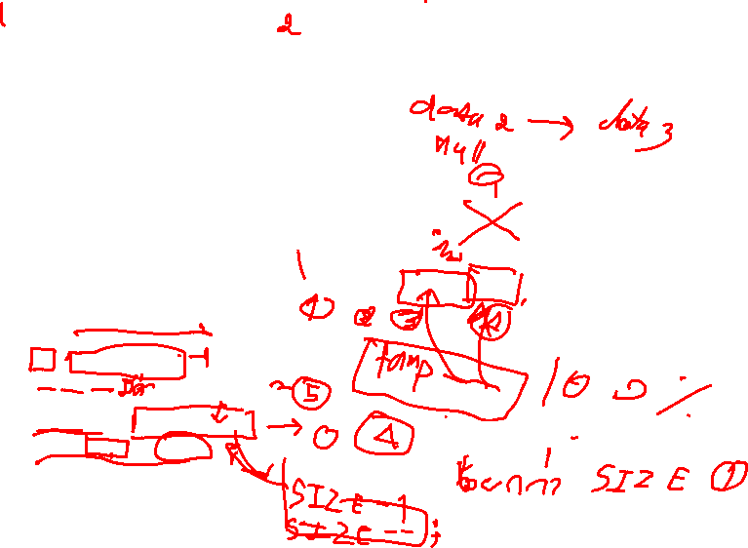
ArrayCollection: remove
void remove(object e)
cap
SIZE
data
5
4
0 | 1 | 2 | 3 | 4
3
Instance
Ant | Bat
Dog
Cat
public void remove(object e)
{
int i = indexOf(e);
if (i != -1)
{
data[i] = data[--SIZE];
data[SIZE] = null;
}
}

Slide 18
Decease Capacity
There are many null in array after removing many elements
ensureCapacity
public void remove(object e)
{
int i = indexOf(e);
if (i != -1)
{
data[i] = data[--SIZE];
data[SIZE] = null;
ensureCapacity();
}
}
private void ensureCapacity()
{
if (SIZE + 1 > data.Length)
{ //Increase Capacity
object[] tempdata = new object[2 * SIZE];
for (int i = 0; i < SIZE; i++)
tempdata[i] = data[i];
data = tempdata;
}
else if (data.Length > cap && data.Length > 2 * SIZE)
{ //Decrease Capacity
object[] tempdata = new object[data.Length / 2 + 1];
for (int i = 0; i < SIZE; i++)
tempdata[i] = data[i];
data = tempdata;
}
}

Slide 19






Complexity of ArrayCollection
Constructor
isEmpty
size
add
Without ensureCapacity
With ensureCapacity
contains [indexOf]
remove [indexOf]
$$Θ(c)$$
$$Θ(1)$$
$$Θ(1)$$
$$Θ(1)$$
$$Θ(n)$$
$$O(n)$$
$$O(n)$$

Slide 20
Classwork 1: ArrayCollection
จงใช้คลาส ArrayCollection เพื่อสร้างโปรแกรมแบบกุยสำหรับเก็บชื่อนักศึกษาโดยมีลักษณะดังนี้
เพิ่มชื่อ
บอกว่าพบหรือไม่พบ
ค้นหาชื่อ
ลบชื่อ
จำนวน 10 คน
ต้องสอดคล้องกับข้อมูลตลอดเวลา

